Slide 1
Clean Code

Slide 2
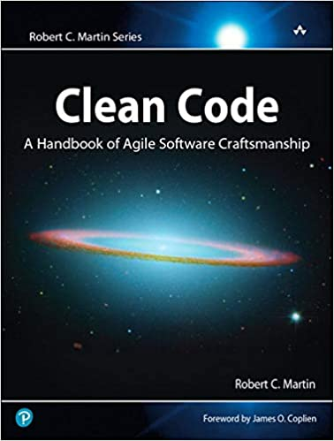

Slide 3
Clean code is code that is easy to understand and easy to change.

Slide 4
"Any fool can write code that a computer can understand. Good programmers write code that humans can understand." – Martin Fowler

Slide 5
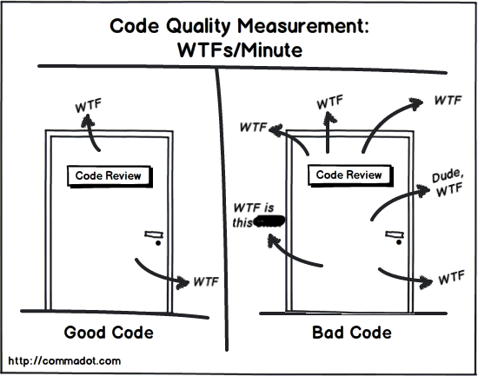

Slide 6
How to Name Variables (and other things)
"There are only two hard things in Computer Science: cache invalidation and naming things." – Phil Karlton

Slide 7
Avoid Noise Words
The (prefix)
Info
Data
Variable
Object
Manager

Slide 8
Use Pronounceable Names
Be Consistent

